Slide 1
ELEC5566M - FPGA Design for System-on-Chip Prof. Steven Freear Module Leader s.freear@leeds.ac.uk ELEC5620M - Embedded Microprocessor System Design Dr. David Cowell Module Leader d.m.j.cowell@leeds.ac.uk
Joint Module Introduction

Slide 2
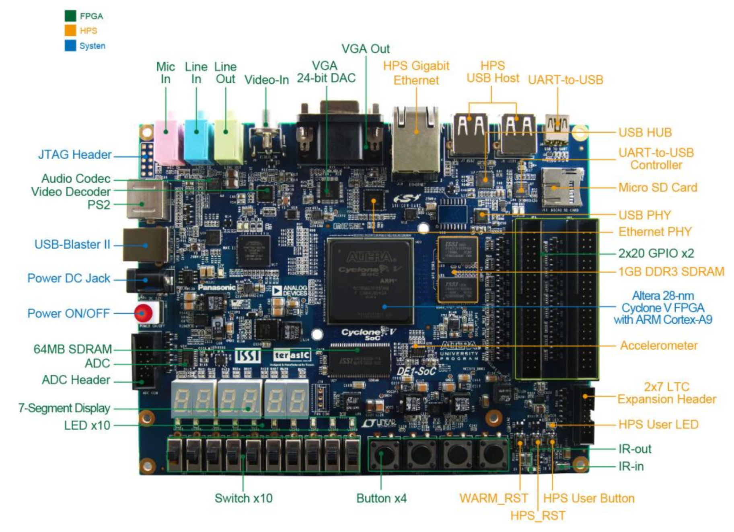
System on Chip (SoC)
Source:
DE1-SoC User Manual
2015.08.05

Slide 3
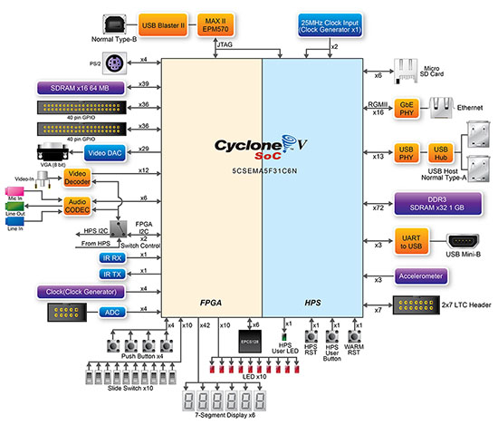
System on Chip (SoC)
Source:
DE1-SoC User Manual
2015.08.05

Slide 4
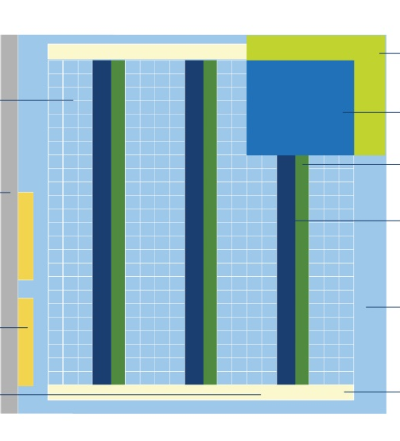
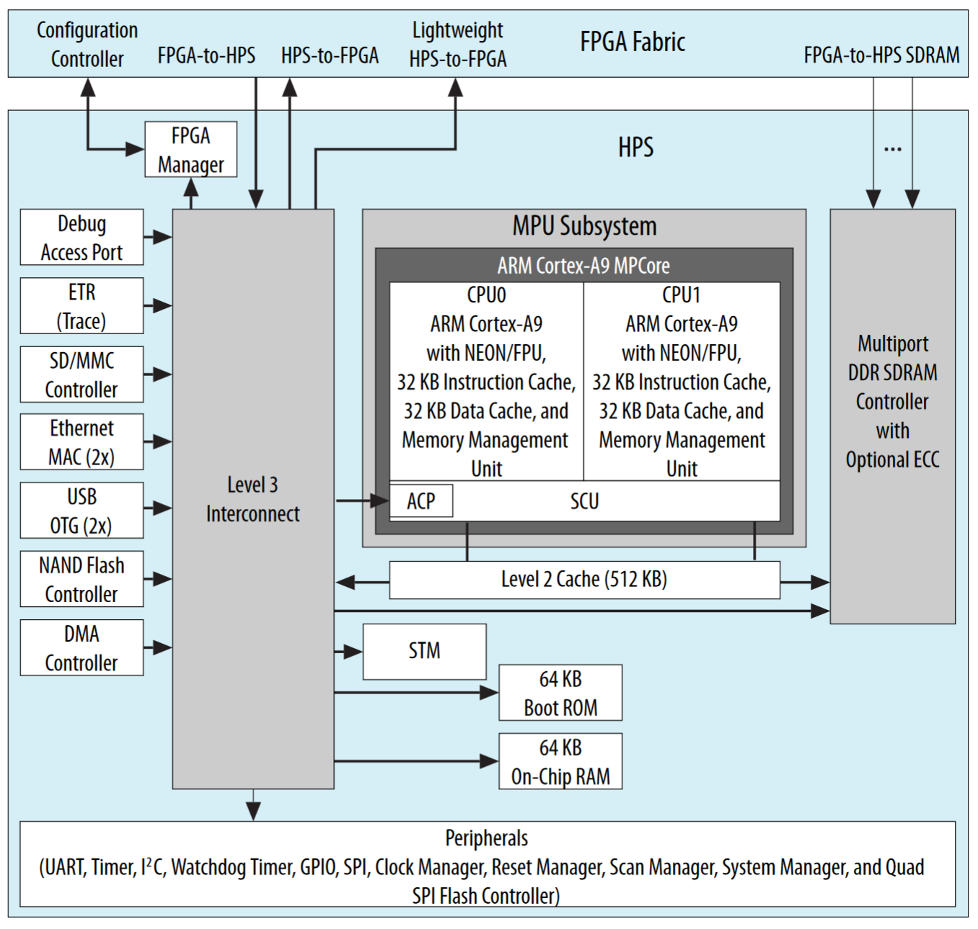
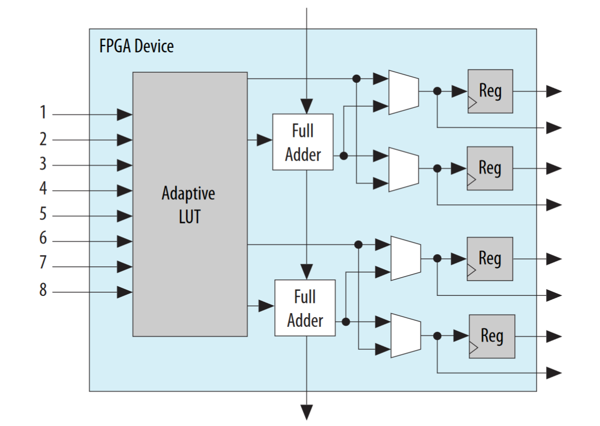
Cyclone V SoC FPGA Hard Processor System - ARM Cortex-A9
x32k
In 1 | 2 | 3 | 4 | 5 | 6 | 7 | 8 | Out 1 | Out 2
0 | 0 | X | X | X | X | X | X | 0 | 0
0 | 1 | X | X | X | X | X | X | 1 | 1
1 | 0 | X | X | X | X | X | X | 1 | 1
1 | 1 | X | X | X | X | X | X | 0 | 1
 |  |  |  |  |  |  |  | XOR | OR
Source: Cyclone V Device Overview, CV-51001 | 2018.05.07

Slide 5
ELEC5566M Module Objectives Minerva > Module Information > Module Structure
On completion of this module students should be able to: 1. Discuss the detailed principles of FPGA systems and their design using a HDL (Verilog).
2. Use contemporary EDA design tools and test-benches for digital design verification.
3. Design sequential systems using finite state machines.
4. Use fixed-point numbering systems to design arithmetic signal processing blocks.
5. Use bus systems for interlinking complex IP blocks.
6. Apply parameterisation and re-use for the generation of IP blocks.

Slide 6
ELEC5620M Module Objectives Minerva > Module Information > Module Structure
On completion of this module students should be able to: 1. Explain a range of options for embedded system implementation.
2. Use System-on-Chip development systems.
3. Apply optimisation tools to embedded processor architectures.
4. Use support tools to design and implement embedded microprocessor systems.

Slide 7
Module Delivery

Slide 8
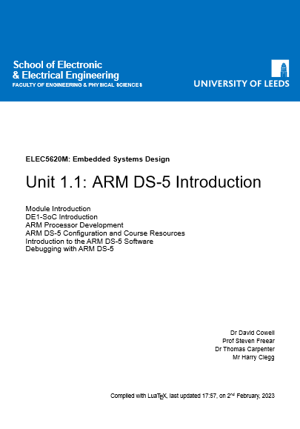
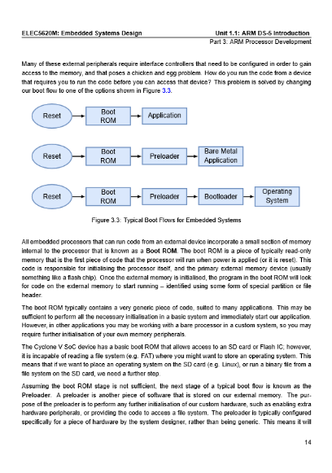
Common Module Format
Joint Module Introduction Lecture – This session
Joint Module Introduction to GitHub Lecture
3 technical units – 2 weeks each
Weekly live lecture
Weekly Written Notes
Read notes BEFORE the attempting practical work. You do not need to be at a computer to read these.
Technical Tasks highlighted in the notes.
Boilerplate code via GitHub Classrooms.
Github Classrooms submission of code for Tasks and Assignments including incremental changes – Industry Standard
Weekly Lab Surgery
Technical Assistance - not a teaching session.

Slide 9
Timetable
ELEC5566M
ELEC5620M
Lectures: Tuesday 12 noon - Check venue in timetable
Lab Surgery: Tuesday 2pm to 4pm - Lab 160 Dedicated lab time – unsupervised: Tuesday 2pm to 4pm - Lab B55a/b
Joint sessions: This joint Introduction lecture. Software Install Surgery Friday 9th Feb 9am-11am – Lab 160 Getting Started with GitHub Friday 9th Feb 2pm-3pm – Mech Eng LT A
Lectures: Monday 2pm – Check venue in timetable
Lab Surgery: Friday 9am to 11am - Lab 160 Dedicated lab time – unsupervised: Friday 9am to 11am - Lab B55a/b

Slide 10
Module Communications
Actions communicated in Lectures – Attend lectures!
General Announcements via Minerva – Interact with Minerva!
Some personal emails – Check emails!
We promise to communicate all key events when you need to know about, consider or action them.
PLEASE DO NOT WORRY ABOUT…
When will….
I have not received…
I heard this from…

Slide 11
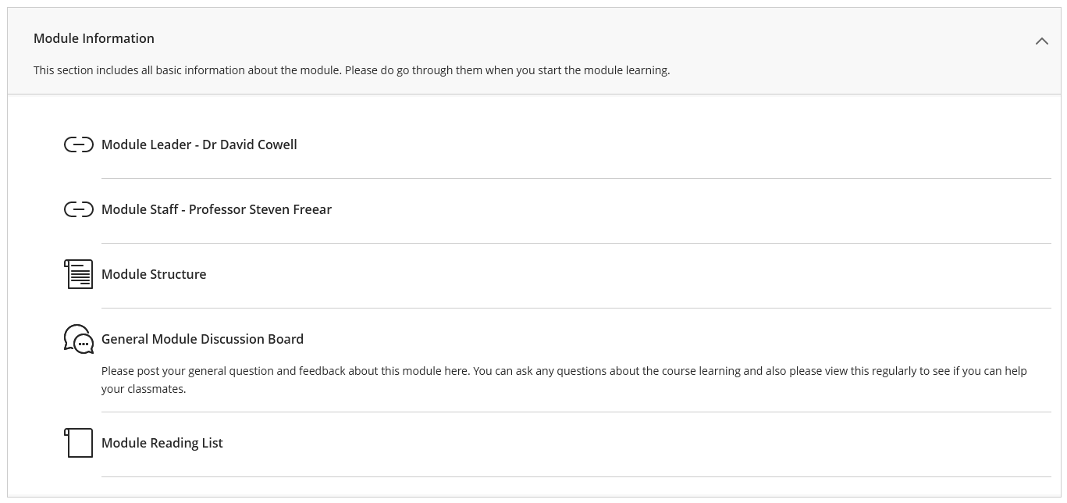
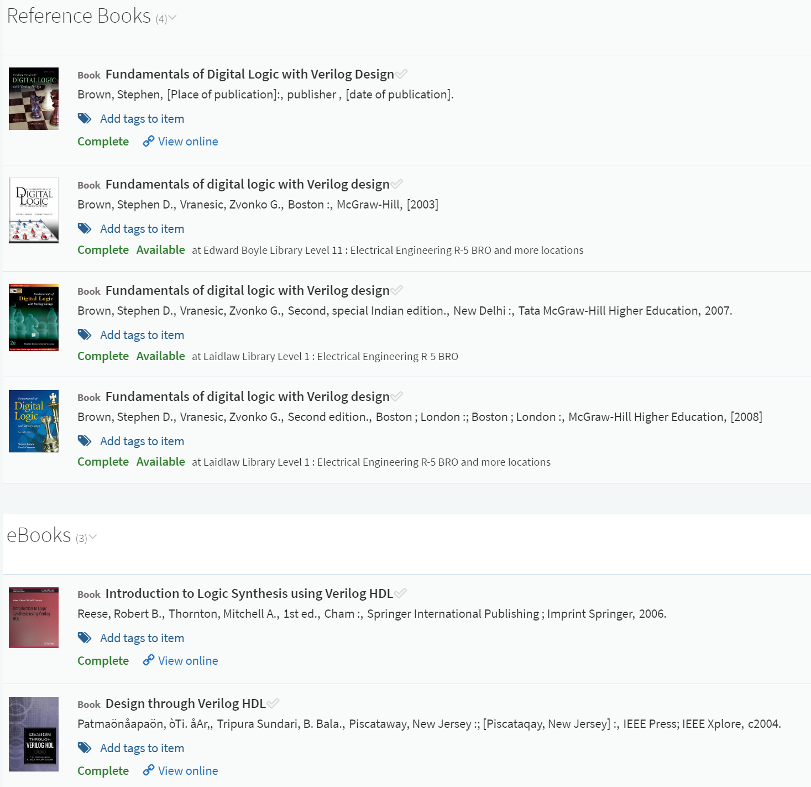
ELEC5566M Module Information > Module Reading List

Slide 12
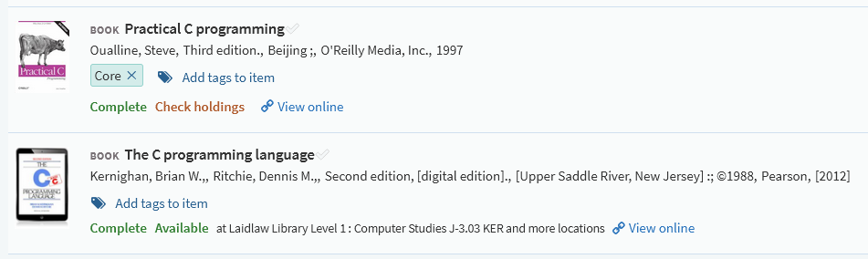
ELEC5620M Module Information > Module Reading List

Slide 13
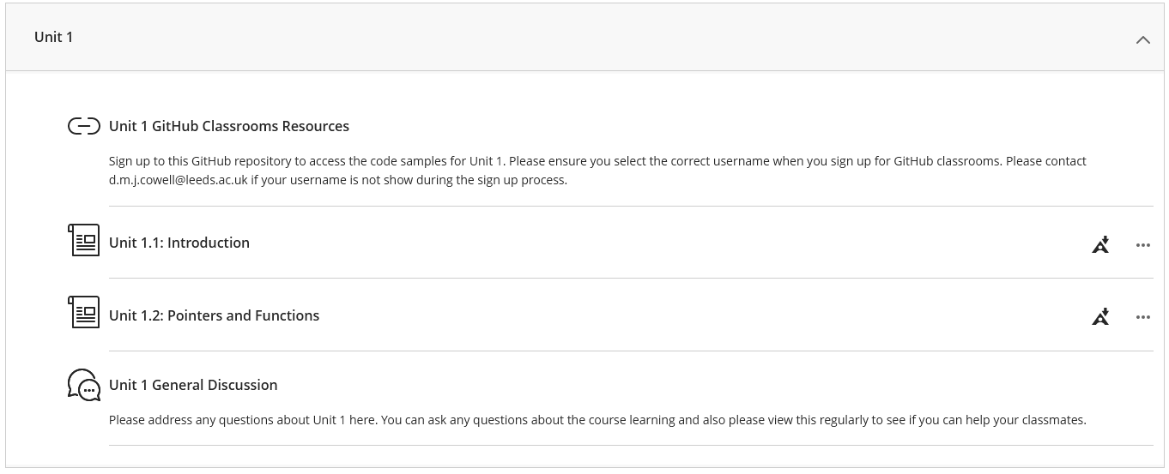
Minerva Units

Slide 14
Unit technical work
Each unit notes contains pre-read material – read these before attempting the technical tasks.
Each unit contains multiple technical tasks – Complete them all
There is a lot to cover in each unit - think about time management.
You are recommended to keep a hardcopy lab book.
The lab book is not assessed, but good practice.
You will need to refer back to previous work.
You can use your lab book during the assessments.
Please note that you cannot bring other lab books, loose leaf notes or text books to the assessment.

Slide 15
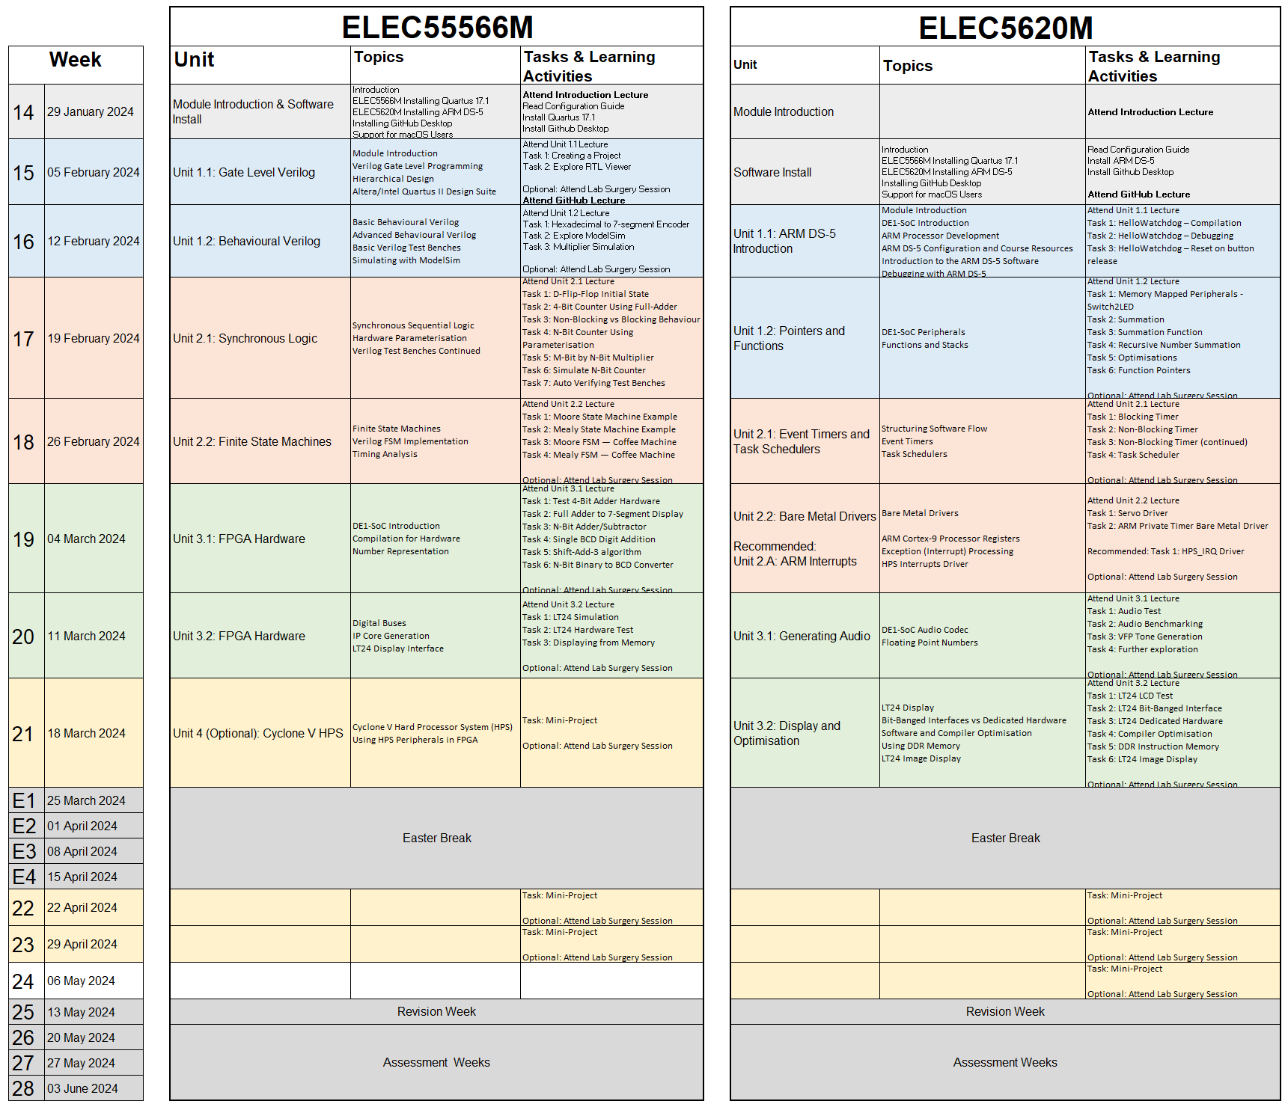
Minerva > Module Information > Module Structure > Weekly Tasks

Slide 16
Assessment

Slide 17
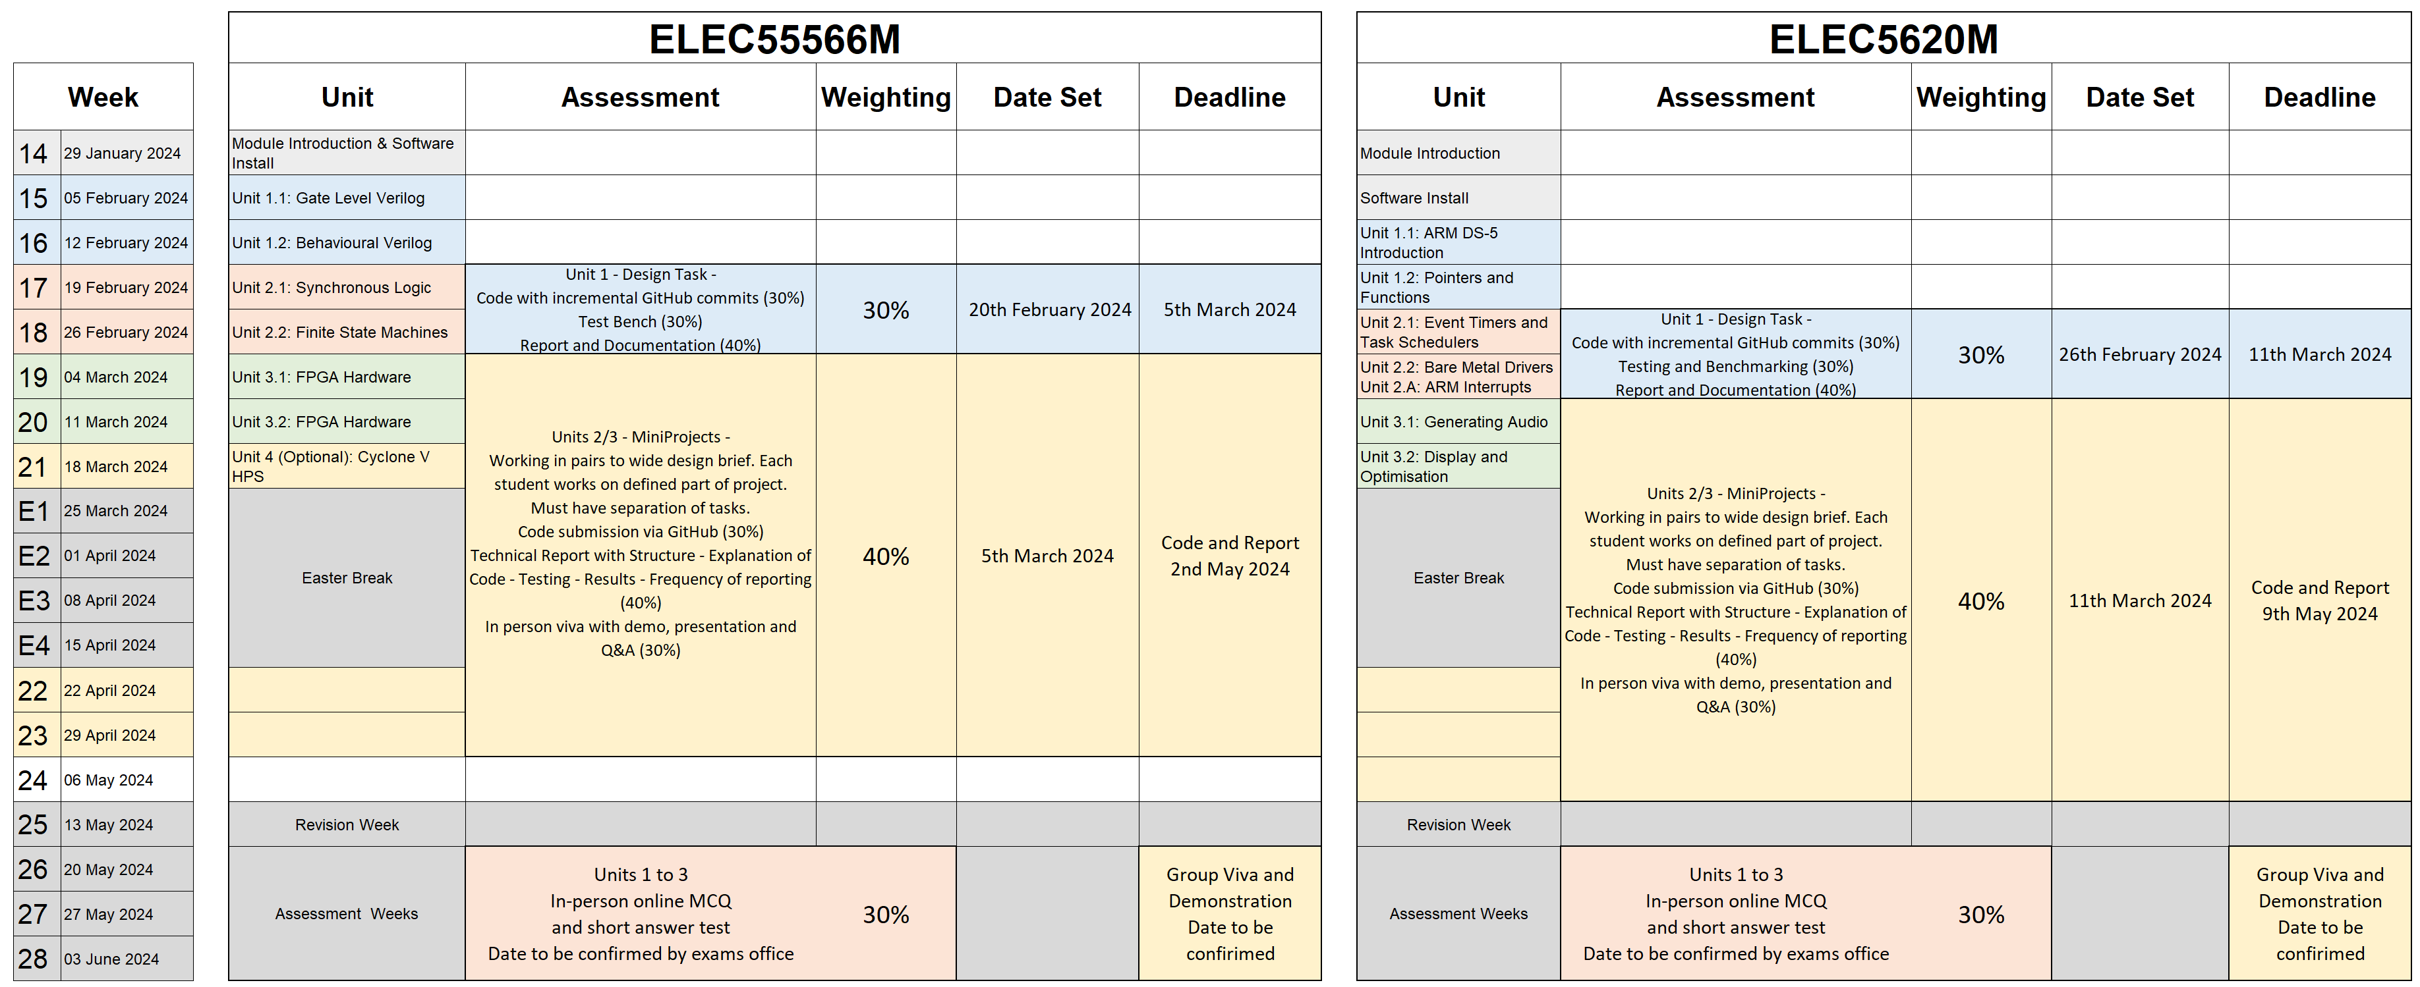
Summative Assessment Minerva > Assessment and Feedback > Assessment Information

Slide 18
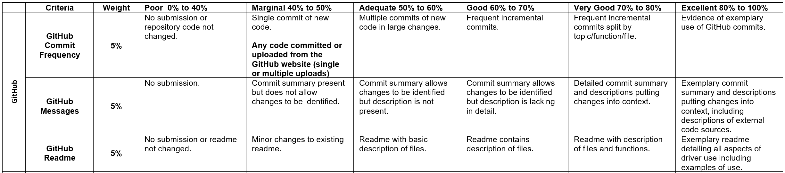
Summative Assessment Written Assignment and Mini-Project
Written Assignment individual – do not work in groups!
Mini-project – groups of 4 – sign up process will be communicated later.
Written Assignment and Mini-Project
Technical reports submitted via Turnitin - Do NOT plagiarise!
Code submitted via GitHub Classrooms - Similarity checks used (e.g. MOSS etc). – Do NOT plagiarise!
Mini-Project – also submit PowerPoint slides and viva of working project
Marking rubrics are provided with each assessment – read them!

Slide 19
Summative Assessment Late submission and extensions
Standard 5% per day (or part of) penalty for late submission
Provisional scores on Minerva do not include any penalties – these are applied separately.
Module staff cannot give any extensions
Request extensions from Student Support Office (SSO) (electronics@leeds.ac.uk) before the deadline.

Slide 20
How much time should I spend on these modules?
There is no large final exam!
15 credit module = 150 nominal hours / 8 weeks = 18.75 hrs / week = 3.75 hrs / working day.
You need to manage your own time - Balance this module with other commitments.
Unit Technical Tasks
Do not spend too much time on one task or assignment to the detriment of other tasks or modules.
Be up to date with module study and tasks for be prepared when assignments are set.
Assignments
You may not be able to answer all parts of the assignment by the deadline.
Meet the deadline [professional engineer].

Slide 21
Software

Slide 22
Minerva > Software Installation
ELEC5566M ONLY Intel Quartus Lite 22.1 Mentor ModelSim 2020.1 GitHub Desktop
ELEC5620M ONLY Arm Development Studio 2022.2 Intel Quartus Programmer 22.1 GitHub Desktop
ELEC5566M AND ELEC5620M Intel Quartus Lite 22.1 Mentor ModelSim 2020.1 Arm Development Studio 2022.2 GitHub Desktop DO NOT INSTALL QUARTUS PROGRAMMER 22.1!

Slide 23
Software Installation
Install the correct software packages based on module enrolment.
DO NOT install the latest versions.
ELEC5566M – No license needed.
ELEC5620M – Arm Development Studio networked license available via VPN.
Please follow Installation Instructions carefully from Minerva > Software Installation
We are all engineers and don’t like to follow instructions BUT this is not a phone app with a one click installation
In the instructions pay attention to file paths, usernames etc (only ASCII characters – no spaces)
Windows – Full instructions and support for installation
macOS x86 – Installed via Windows running on Bootcamp or Virtual Machine (e.g. VMWare Fusion)
Installation notes for VMWare Fusion method are provided on Minerva.
Note: The software is not currently directly compatible with M series processor Apple computers.
Linux – Install packages are available from Intel and Arm
Untested and no support available – You are on your own, but this is probably why you use Linux!

Slide 24
General Resources

Slide 25
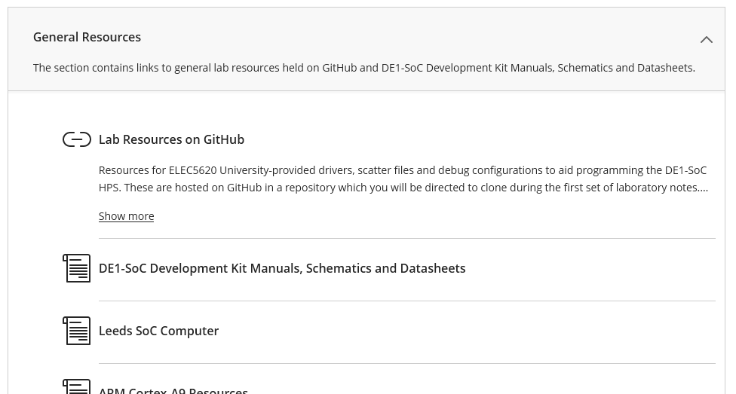
Minerva > General Resources

Slide 26
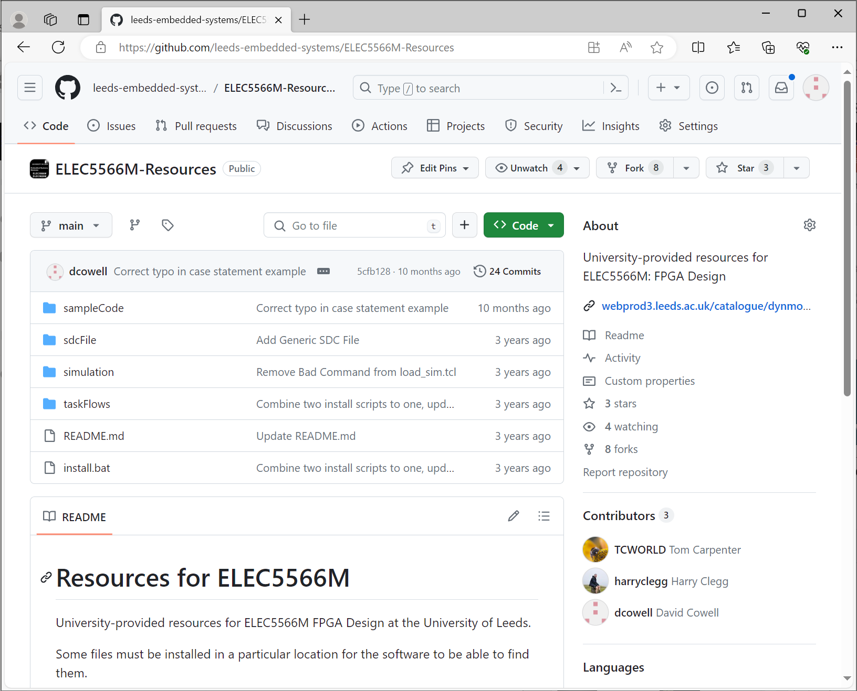
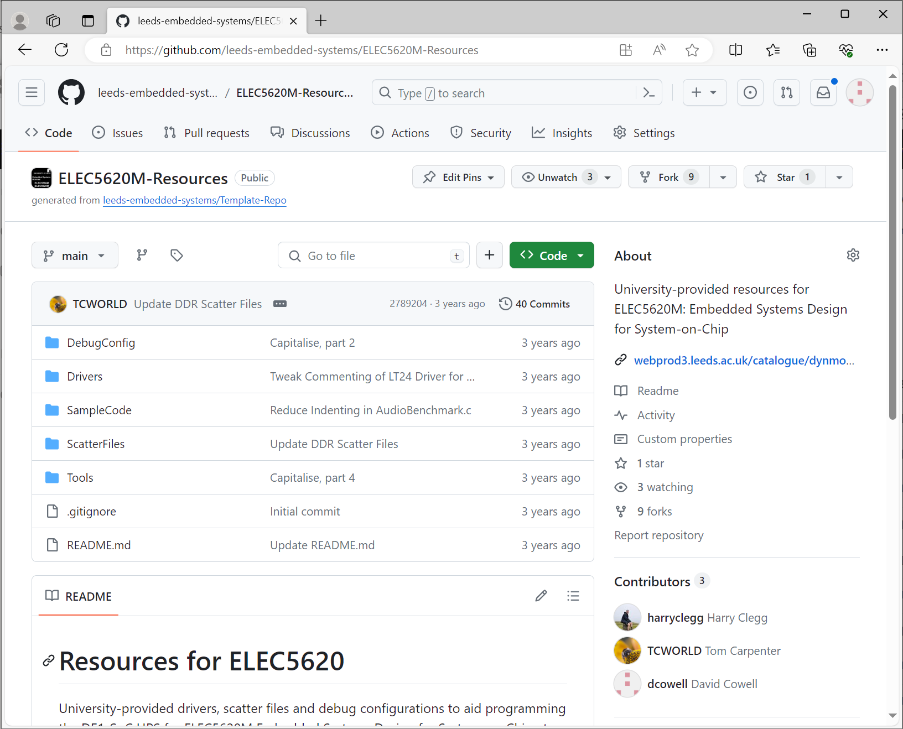
Minerva > General Resources > Lab Resources on GitHub

Slide 27
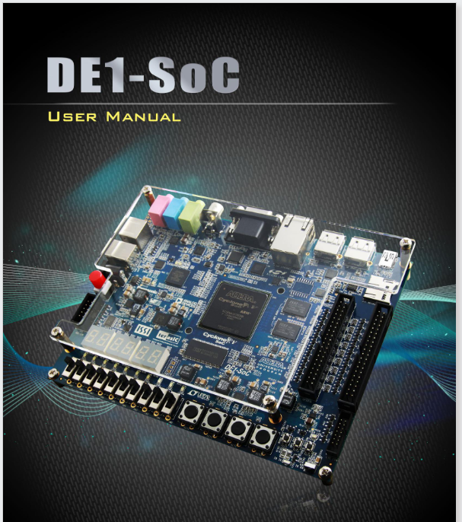
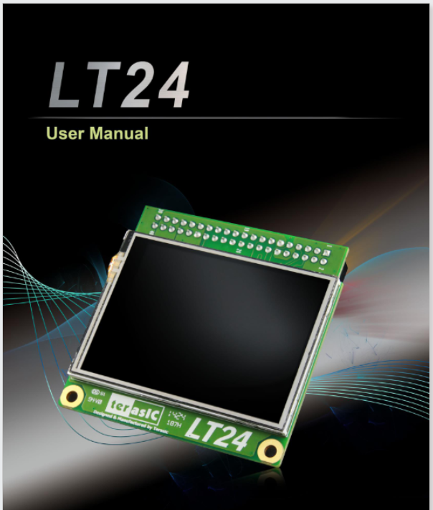
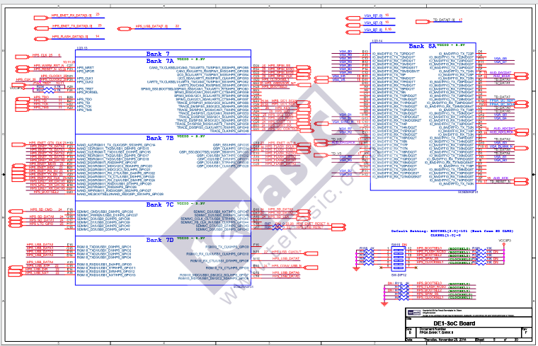
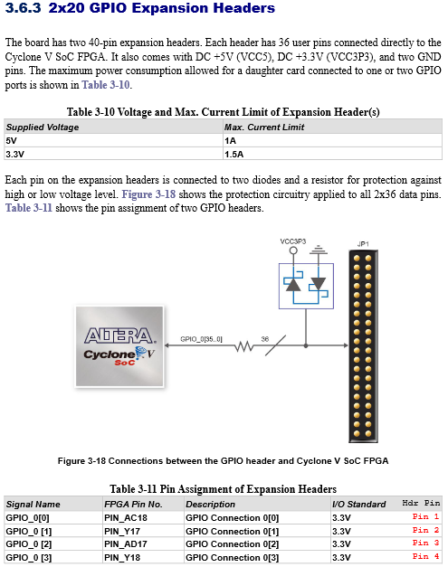
Minerva > General Resources > DE1-SoC Development Kit Manuals, Schematics and Datasheets

Slide 28
Hardware

Slide 29
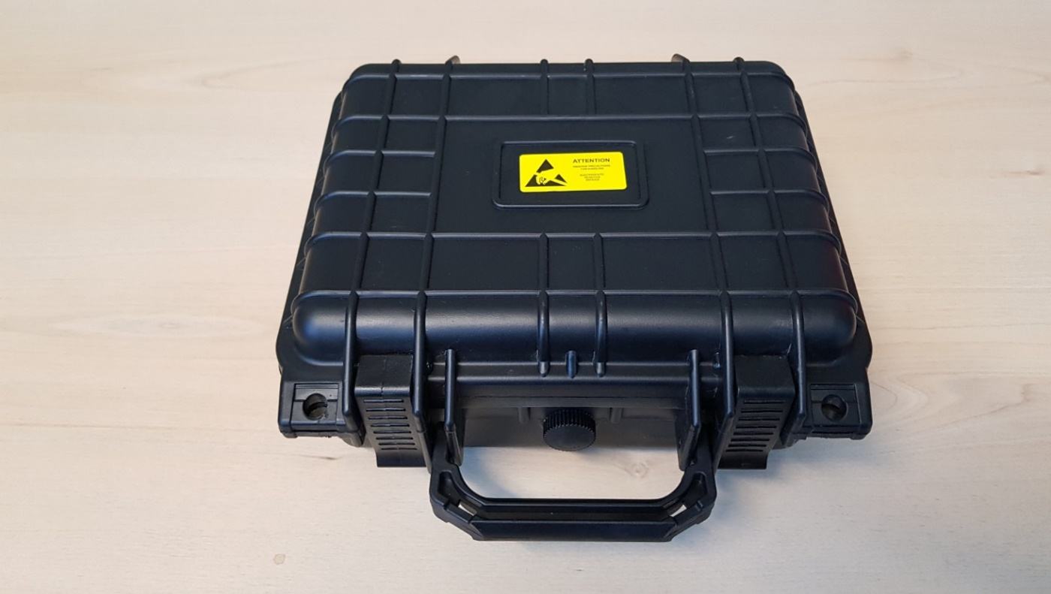
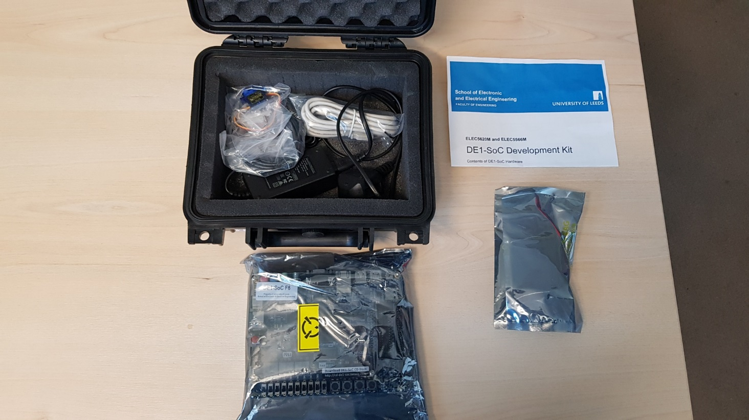
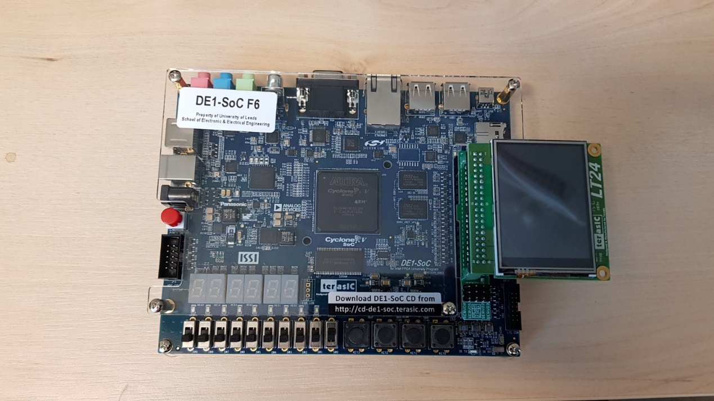
DE1-SoC Hardware
Each student is loaned a DE1-SoC Kit in Unit 3 Expensive system ~£250
You cannot graduate until your DE1-SoC and accessories are returned!
Can be used for projects after the module with prior agreement.
Do not dispose of the packaging material. Use it when returning kit.
Take ESD precautions. Do NOT touch exposed connections.
Take care plugging in LCD. Check alignment.
Notes:
ELEC5566M Lab 4

Slide 30
DE1-SoC Hardware Health and Safety Rules!
DO NOT leave DE1-SoC hardware unattended if plugged in to AC power supply.
Always use the supplied power supply lead (C8).
Always check the power cable for damage before use.
Always operate hardware on a non-flammable work surface.
Do NOT use the metallic ESD bags as a work surface – they are electrically conductive.
DO NOT cover hardware – no paper, clothes etc.
DO NOT have liquids or food near hardware.
If ANY problem, unplug from AC power supply and computer, then report to module leader.

Slide 31
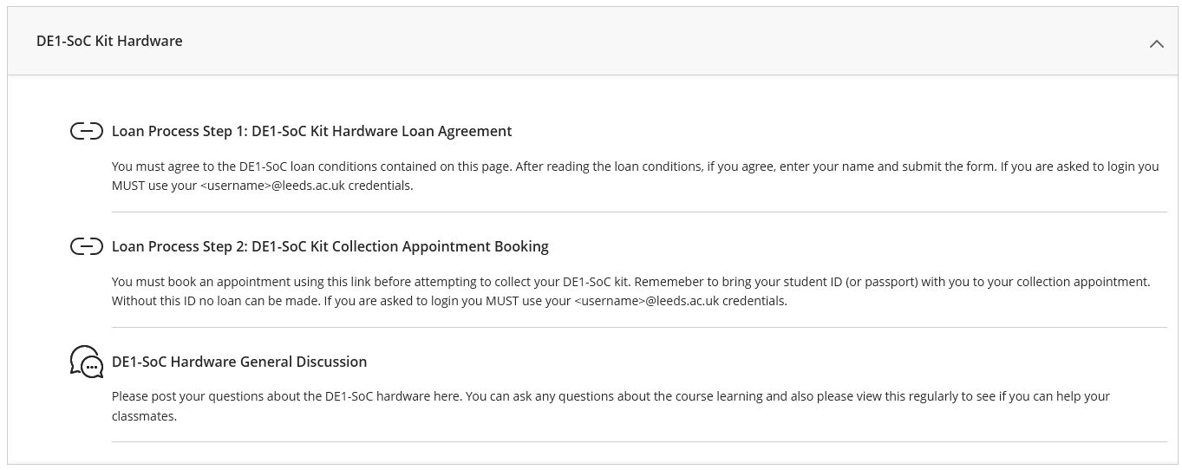
Hardware Loan
Wait for module announcement inviting you to borrow hardware.

Slide 32
Next steps

Slide 33
Actions

Slide 34
Preparation tasks
Minerva > Learning > Learning Resources > Software Installation
Install EDA software – See previous slide for required list
Install GitHub Desktop
Sign up for GitHub Account
Use provided resources!!!
Notes: Minerva > Software Installation > Software Configuration Guide

Slide 35
Revision
General background – ELEC5566M and ELEC5620M
Number bases – Decimal, Hexadecimal and Binary including conversion
Operators – Bitwise and Logical operators - AND, OR, XOR, NAND, NOT
Flow Control – If Else, While, Do While, For
ELEC5620M
C pointers

Slide 36
Have fun and enjoy the Embedded Systems modules!

Slide 37
Appendix: Hardware Loan Process

Slide 38
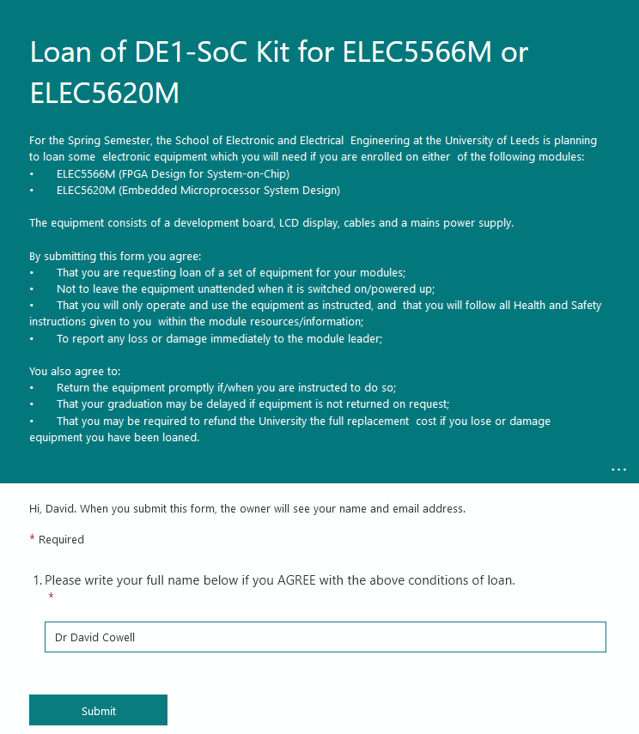
Hardware Loan

Slide 39
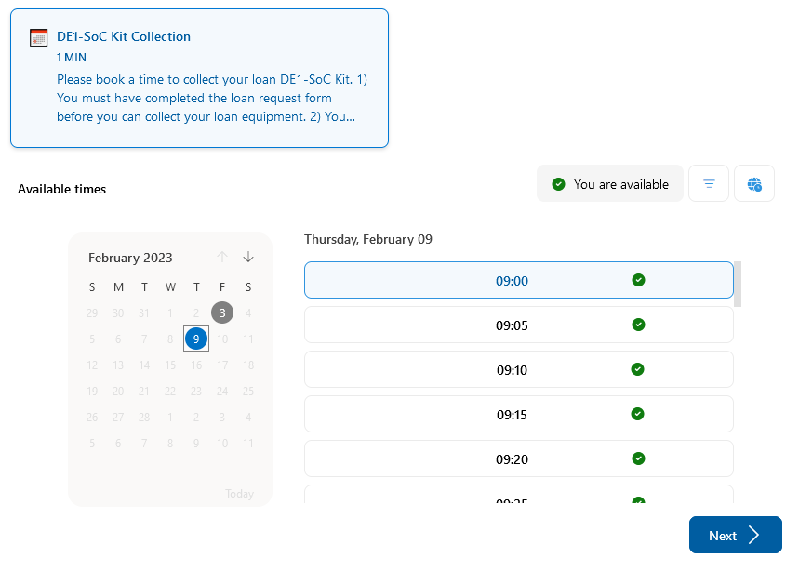
Hardware Loan

Slide 40
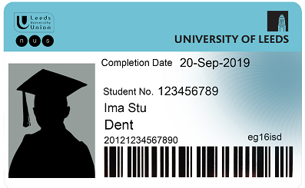
Hardware Loan

Slide 41

Hardware Loan

Slide 42

Hardware Loan

